Slide 1



UNIT-1 INTRODUCTION
BY Loknath Regmi

Slide 2
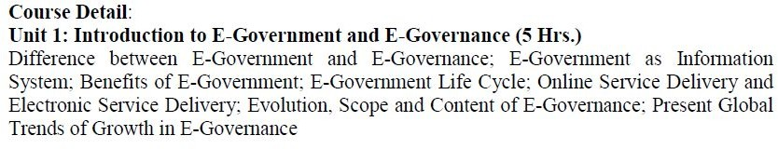
SYLLABUS

Slide 3
E-government
□E-government is the use of technological communications devices, such as computers and the Internet to provide public services to citizens and other persons in a country or region.
□It refers to the implementation of information and communication technology.
□Through the use of technology, it improves the government activities and process.

Slide 4
Four Domains of e-Government
□e-Administration – Improving government processes by using ICTs and government process management. No paperwork, each and every process need to be done via the use of ICT.
□e-Government services – Delivering government services electronically to citizens, businesses, and government employees. Example- application for citizenship through the online system.
□e-Democracy – Improving transparency and democratic decision making, as well as citizens’ participation in public decisions. e-Voting is a perfect example here.
□e-Governance – It is a development, deployment, and enforcement of the policies, laws, and regulations necessary for developing cooperation, networking and partnerships between government units, citizens and the business. Citizen will get government services using technology.

Slide 5
Beneﬁts of e-Government
□Better provision of government services
□Improved interaction with diﬀerent groups and citizen
□Citizen empowerment through access to information
□Eﬃcient government management
□Easy implementation of Right to Information
□It is a two-way process Government to citizen and vice versa.

Slide 6
E GOVERNANCE
□It is a part of e-Government.
□E-Governance is dealing with all regulations and policies to control the services provided by the e-Government.
□However, the E-Government is an electronic government, which should be regulated by the E-Governance.
□e-Governance refers to the utilization of information and communication technology (ICT) for providing government services, disseminating information, communication operations with the general public.

Slide 7
Beneﬁts
of e-Governa
□Better provision of government services
□Improved interaction with diﬀerent groups
□Citizen empowerment through access to information
□Eﬃcient government management
nce

Slide 8
Key diﬀerence between
e-Government & e-Governance?
e-Government is a system whereas e-Governance is a functionality
e-Government means the application of ICT in government operations, as a tool to make better government. e-Governance, on the other hand, implies the use of ICT in transforming and supporting functions and structures of the system.
It is a one-way protocol but e-Governance is a two-way protocol(government to citizen and vice versa)
e-Governance is the part of e-Government. e-Governance never comes alone.

Slide 9
Good Governance
Good governance can be enabled by e governance if it is implemented properly.
Here good governance stands for SMART (Simple, Moral, Accountable, Responsive and Transparent) governance which is very important for developing nations.
It is needed for public or citizen to interact with government through electronics means in order to get the services as ease.

Slide 10
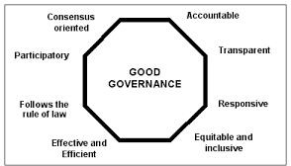

Slide 11
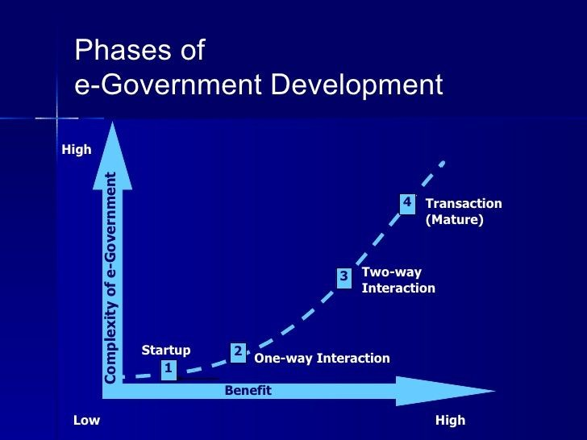
Phase of e-
Governanc e

Slide 12
G2G(Government to Government)
G2C(Government to Citizen) G2B(Government to Business) G2E(Government to Employee)
Types of
e-governanc e

Slide 13
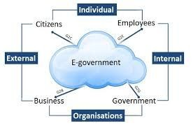

Slide 14
Government-to-Citizen (G2C):
The Government-to-citizen mentions the government services that are acquired by the citizens.
Most of the government services come under G2C.
Similarly, the primary aim of Government-to-citizen is to supply facilities to the citizens.
It also helps the ordinary people to minimize the time and cost to carry out a transaction.
A citizen can retrieve the facilities anytime from anywhere.
Paying the administrative fee online is also possible due to G2C.
The facility of Government-to-Citizen allows the ordinary citizen to outclass time limitation.
It also focuses on geographic land barriers.

Slide 15
Government-to-business (G2B):
The Government-to-business is the interchange of services between Government and Business ﬁrms.
It is productive for both government and business ﬁrms. G2B provides access to pertinent forms needed to observe.
It also contains many services interchanged between business sectors and government.
Similarly, the Government-to-business provides timely business information.
A business organization can have easy and easy online access to government agencies. G2B plays a important role in business development.
It upgrades the eﬃciency and quality of communication and transparency of government projects.
Eg: Insurance, taxation

Slide 16
Government-to-Government (G2G):
The Government-to-Government mentions the interaction between diﬀerent government departments, ﬁrms and agencies.
This increases the eﬃciency of government processes.
In G2G, government agencies can share the same database using online communication. The government departments can work together.
This service can increase international discretion and relations.
G2G services can be at the local level or at the international level. It can convey with both global government and local government.
It also provides safe and secure inter-relationship between domestic or foreign government. G2G builds a universal database for all members to upgrade service.

Slide 17
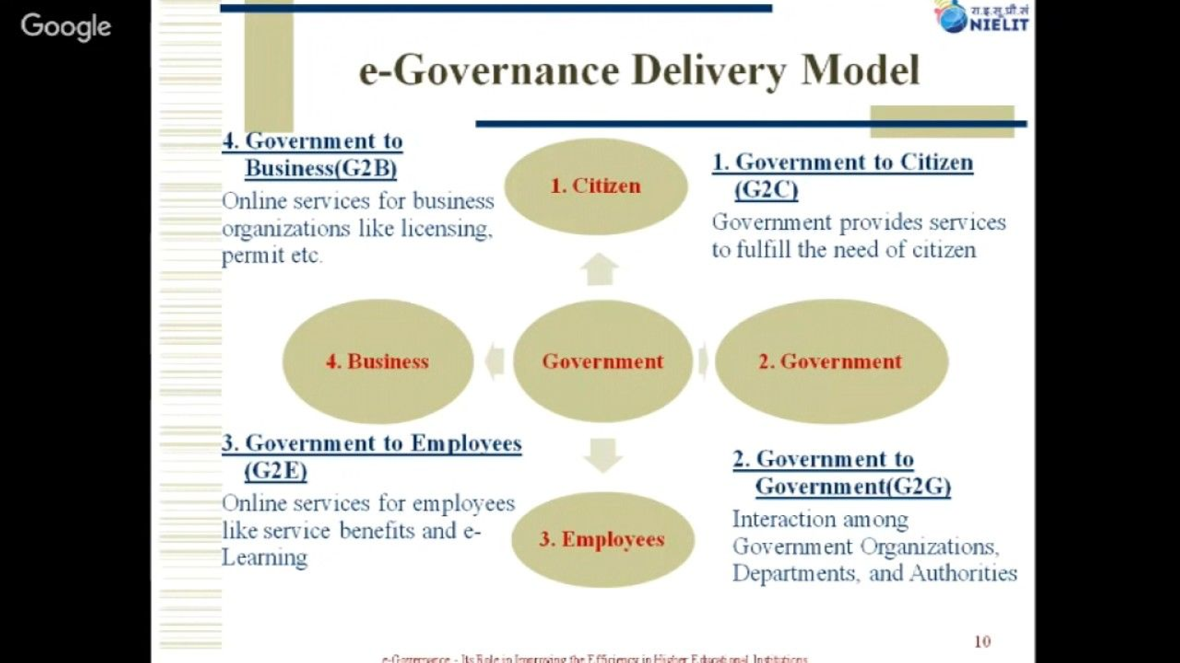

Slide 18
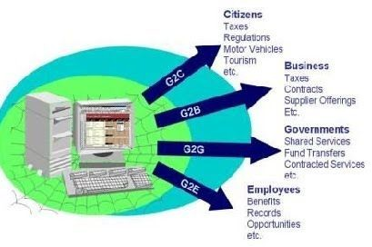

Slide 19
NEED OF E GOVERNANCE
□To provide SMART government.
□Information delivery is greatly simpliﬁed for citizens and businesses.
□It gives varied departments’ information to the public and helps in decision making.
□It ensures citizen participation at all levels of governance.
□It leads to automated services so that all works of public welfare is available to all citizens.

Slide 20
ØIt revolutionizes the functions of the government and ensures transparency.
ØEach department and its actions is closely monitored.
ØPublic can get their work smartly done and save their time.
ØIt provides better services to citizens and brings government close to public. Public can be in touch with the government agency.

Slide 21
MIDDLEMAN PROBLEM
□It cuts middlemen and bribery if any from the picture.
□The main diﬃculty faced by peoples while dealing with government work is the delay and the problem created by the middleman.
□Hence to minimize the interruption of middleman and make it easy for people to get all the services provided by the government.

Slide 22
Evolution of E-Governance, Its Scope and Content
□ASSIGNMENT : READ FROM BOOK

Slide 23
Present Global Trends of Growth in
E-Governance: Other Issues
CLASSWORK:
IN A GROUP OF FOUR STUDENTS … DISCUSS ABOUT PRESENT TREND OF E-GOVERNANCE IN NEPAL.
REF: TAKE REFERENCE FROM BOOK

Slide 24
E-GOVERNMENT AS INFORMATION SYSTEM
To understand this topics we need to ﬁrst know some terms like information technology, system information system and E-Government system.
Information technology (IT) is the use of any computers, storage, networking and other physical devices, infrastructure and processes to create, process, store, secure and exchange all forms of electronic data.

Slide 25
System is deﬁned as a set of components for collecting, creating, storing, processing,
and distributing information, typically including hardware and software, system users, and the data.
“Information systems are interrelated components working together to collect, process, store, and disseminate information to support decision making, coordination, control, analysis, and visualization in an organization.”

Slide 26
E-Government means oﬃce automation and internal management information systems and expert systems, as well as client-facing web sites. it must be seen to consist of technology plus information plus people who give the system purpose and meaning plus work processes that are undertaken.

Slide 27
E-Government as Information System can be represented as ‘onion-ring’ model. It consist of two parts: one inner part and other outer part.
Inner part represent the Information system and the outer part consist of Organization and Environment.
Information: Information is a set of data which is processed in a meaningful way according to the given requirement. Information is processed, structured, or presented in a given context to make it meaningful and useful.
Data is a raw and unorganized fact that required to be processed to make it meaningful.

Slide 28
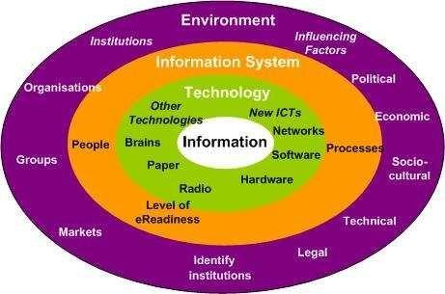

Slide 29
Knowledge is facts, information, and skills acquired through experience or education; the theoretical or practical understanding of a subject.
Technology: Technology is the sum of techniques, skills, methods, and processes used in the production of goods or services or in the accomplishment of objectives, such as scientiﬁc investigation. It consist of Hardware, Software, Telecom etc.
Information systems are interrelated components working together to collect, process, store, and disseminate information to support decision making, coordination, control, analysis, and visualization in an organization.

Slide 30
Processes: The activities undertaken by the relevant stakeholders for whom the e-government system operates, both information-related processes and broader business processes.
Objectives and values: Often the most important dimension since the objectives component covers issues of self-interest and organizational politics, and can even be seen to incorporate formal organizational strategies; the values component covers culture: what stakeholders feel are the right and wrong ways to do things.
Staﬃng and skills: Covers the number of staﬀ involved with the e-government system, and the competencies of those staﬀ and other users.

Slide 31
Management systems and structures: The overall management systems required to organize operation and use of the e-government system, plus the way in which stakeholder agencies/groups are structured, both formally and informally.
Other resources: Principally, the time and money required to implement and operate the e-government system.
Outside world: The political, economic, socio-cultural, technological and legal factors

Slide 32
E-GOVERNMENT LIFE CYCLE
E-Government development project typically consists of ﬁve stages; (1) project assessment,
(2) analysis of current reality, (3) design of the new system, (4) system construction, and (5) implementation and beyond.

Slide 33
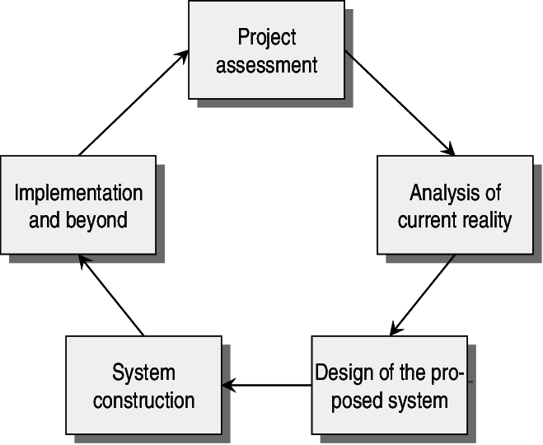

Slide 34
Project assessment
Project assessment, in the development model is the identiﬁcation of possible e-government projects.
At this stage the outline of basic project parameters is completed, with the assessment of whether or not to proceed with a project.
New e-government projects are typically initiated based on: “a problem that needs to be solved” or “identiﬁcation of an opportunity which could be seized” .

Slide 35
That kind of opportunity can arise from several diﬀerent sources, such as from internal sources or external (environmental) sources.
Examples of external sources are: complaints from the media, politicians or citizens, new legislations or directives, technological innovation, and economic crises.
Examples of internal sources are: strategic planning, staﬀ problems, and the individual’s desire to give his/her career a boost .

Slide 36
Analysis of current reality
Analysis of current reality means that descriptions of information, technology, processes, objectives and values, staﬃng and skills, management systems and structures, and other resources such as money and time are created.
This stage consists of a mixture of hard and soft techniques such as an information systems audit, an information systems analysis, a problem analysis, a context analysis, etc., in order to build an overall picture.
A SWOT-analysis can, for example, be performed .

Slide 37
Design stage
The design stage of the proposed new situation consists of setting objectives related to the above mentioned dimensions of the new system – putting together the diﬀerent objectives for the new system to meet.
In this stage issues of software and hardware need to be dealt with.
Work processes are also necessary to take into account from a design perspective, and not just the front-end processes, but also the underlying processes.

Slide 38
System construction
System construction consists of the process and activities in acquiring any new IT, undertaking detailed design of the new e-government system (for example a system installation), building it, testing it, and documenting it.

Slide 39
Implementation
Implementation and beyond is represented by the planning of implementation processes,
for example: training users to use the new information system; converting data from old to new formats; systems maintenance activities; introducing the new e-government system; monitoring and evaluating its performance and context; and undertaking necessary activities
.
The eﬀorts concerning post implementation tasks such as marketing and support, in order to avoid the common “build it and they will come” strategy, are also important .

Slide 40
ONLINE SERVICE DELIVERY AND ELECTRONIC SERVICE DELIVERY
Online service delivery is an eﬀective way to build closer relationships with customers, partners, and the public while simultaneously cutting costs and reducing delays.
Increasingly, organizations across a number of sectors are oﬀering external-facing online services. They are also looking for the best ways to overcome challenges presented by registering and managing external identities, providing secure authentication, and managing access rights.
Electronis Service delivery or ESD refers to providing government service through the internet or other electronics means. It is related to e- service and e -government .
E service is highly generic term usially referring to " The provision of service via the internet".
Thus e service may also include e commerce although it may also include non commercial sevices(online) which is usually provided by the government (Main focus is government service provide by government to public)

Slide 41
ASSIGNMENT:
WRITE AT LEAST FIVE DIFFERENCE BETWEEN ONLINE SERVICE DELIVERY AND ELECTRONIC SERVICE DELIVERY.

